Slide 1
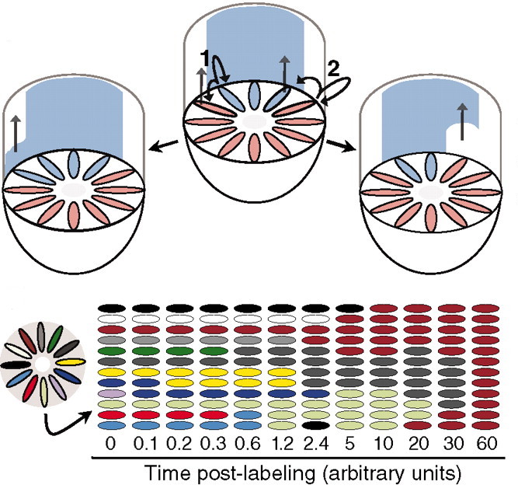
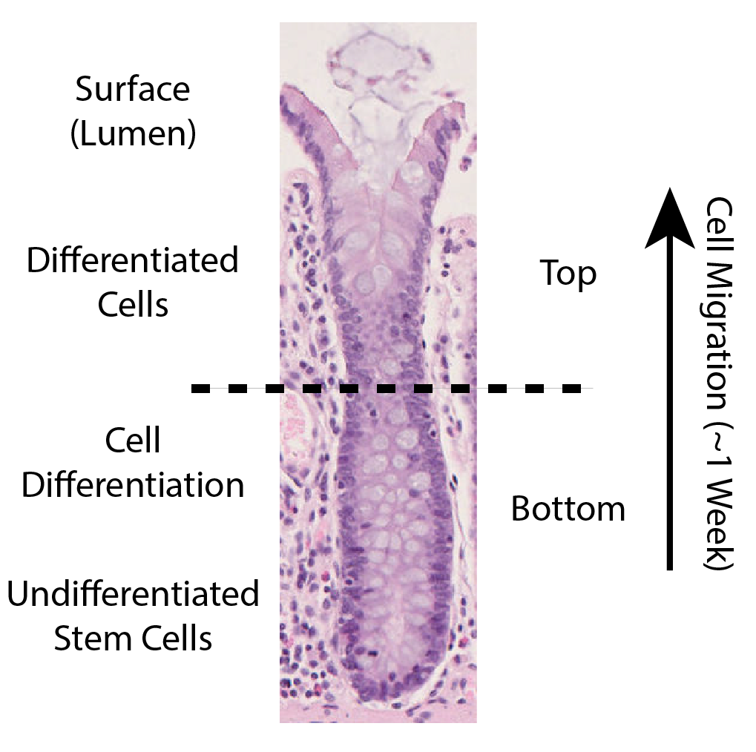
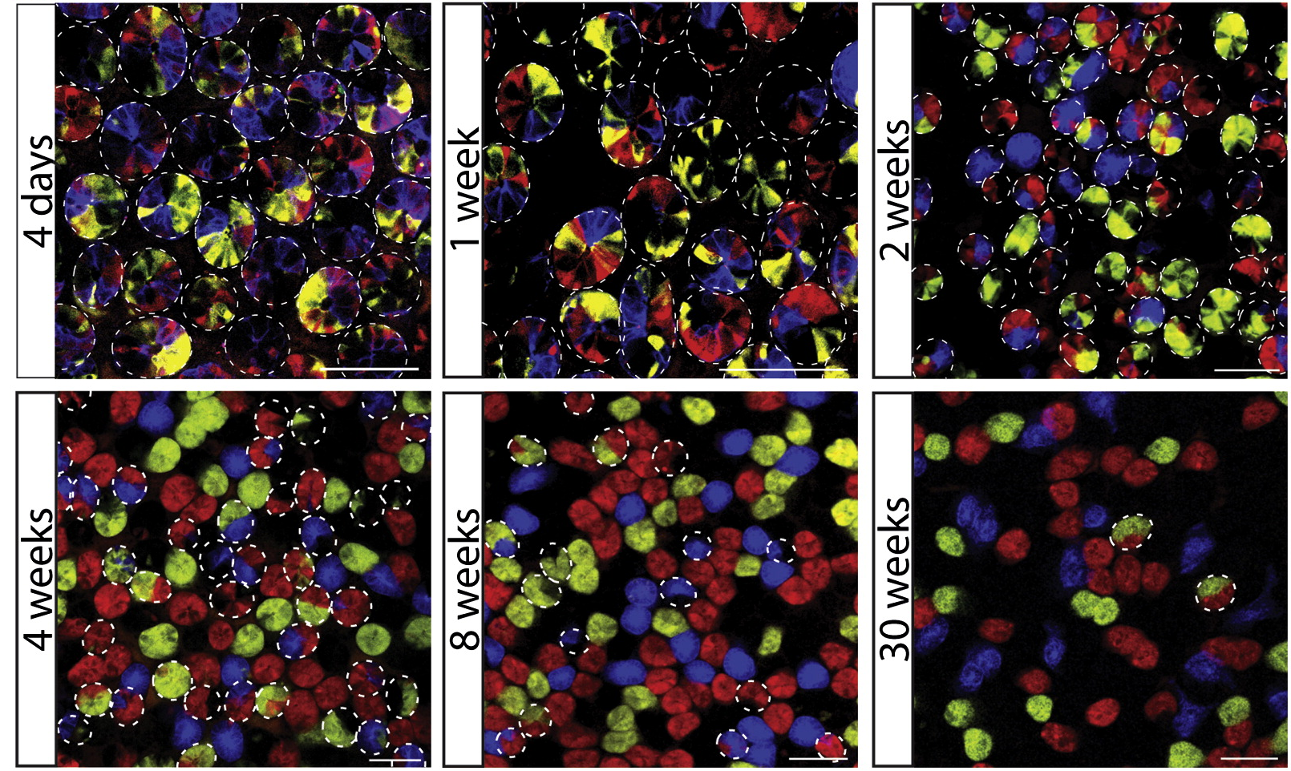
Example biological problem – Stem cell dynamics of colonic crypts
Lopez-Garcia, C. et al. (2010)
Snippert, H. J. et al. (2010)

Slide 2
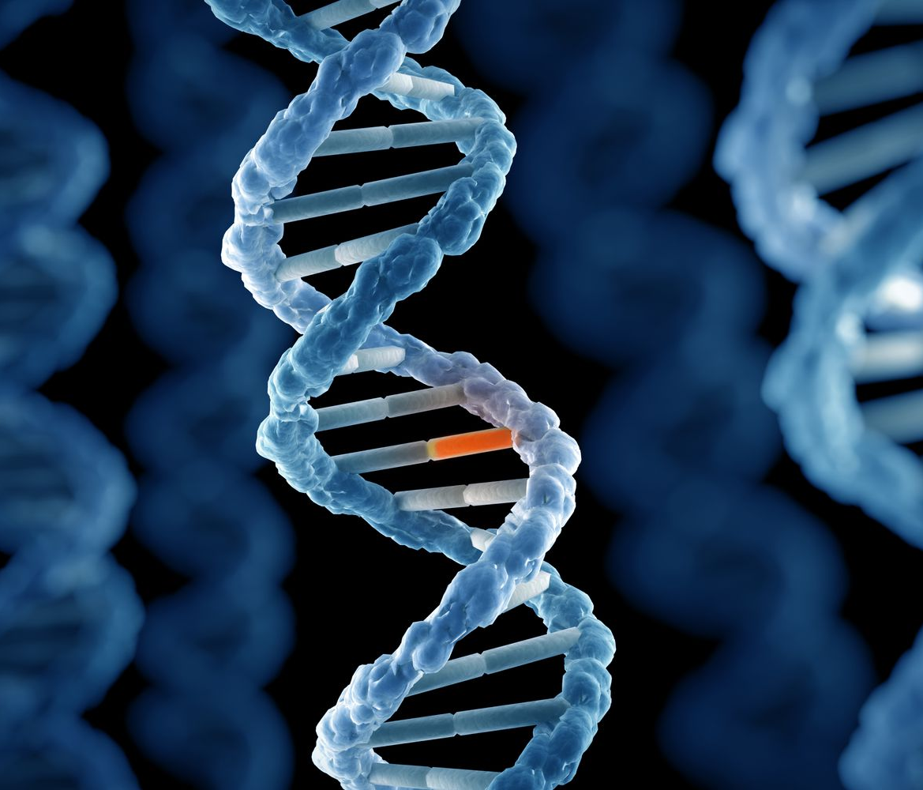
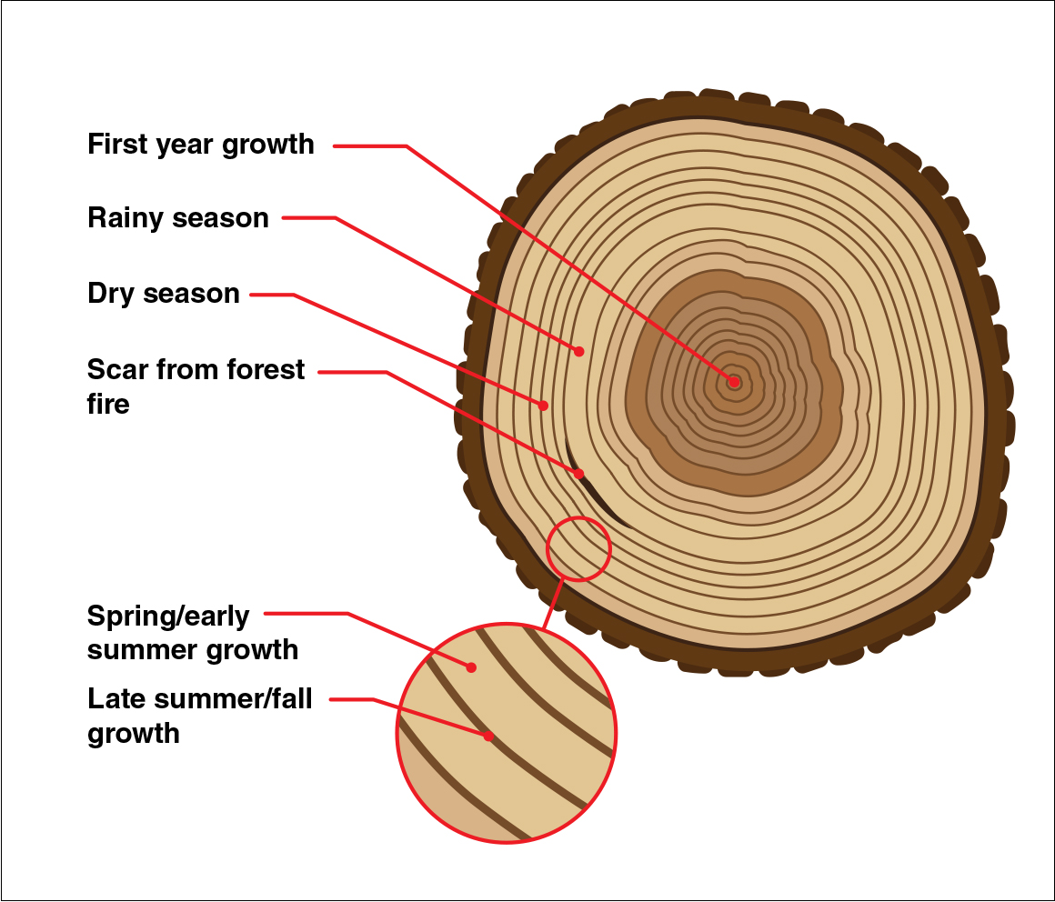
The evolutionary history of populations of cells are encoded in thier DNA

Slide 3
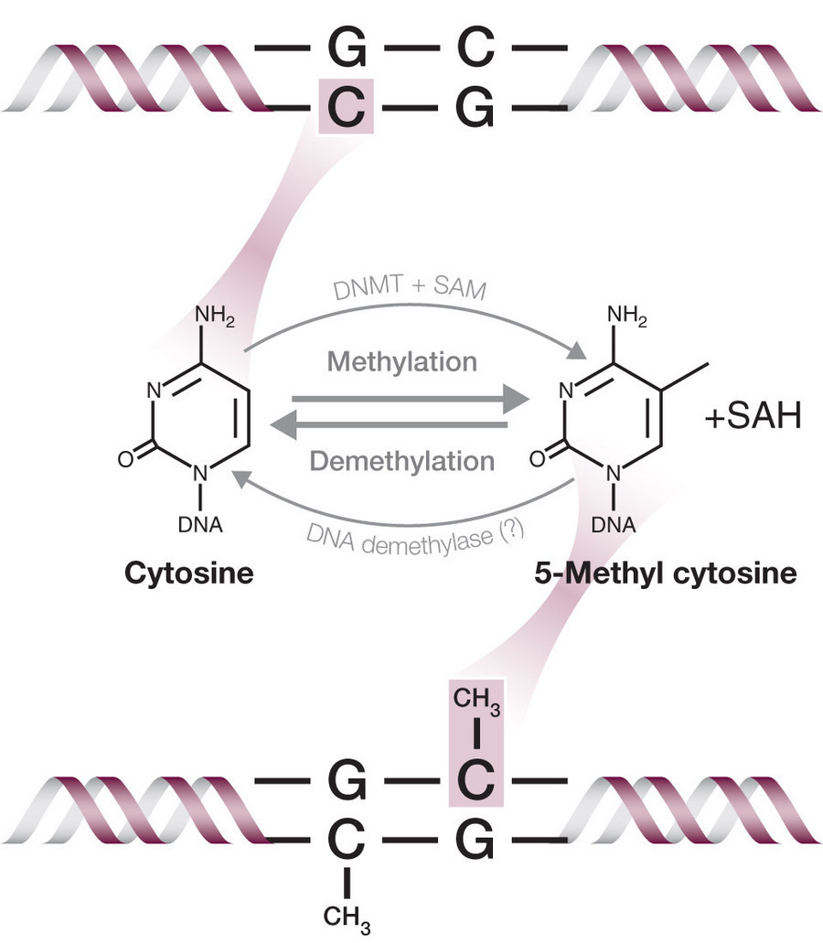
DNA methylation as an alternative lineage tracing marker to point mutations
DNA methylation is heritable, but can change state at a much greater rate than DNA mutations occur

Slide 4
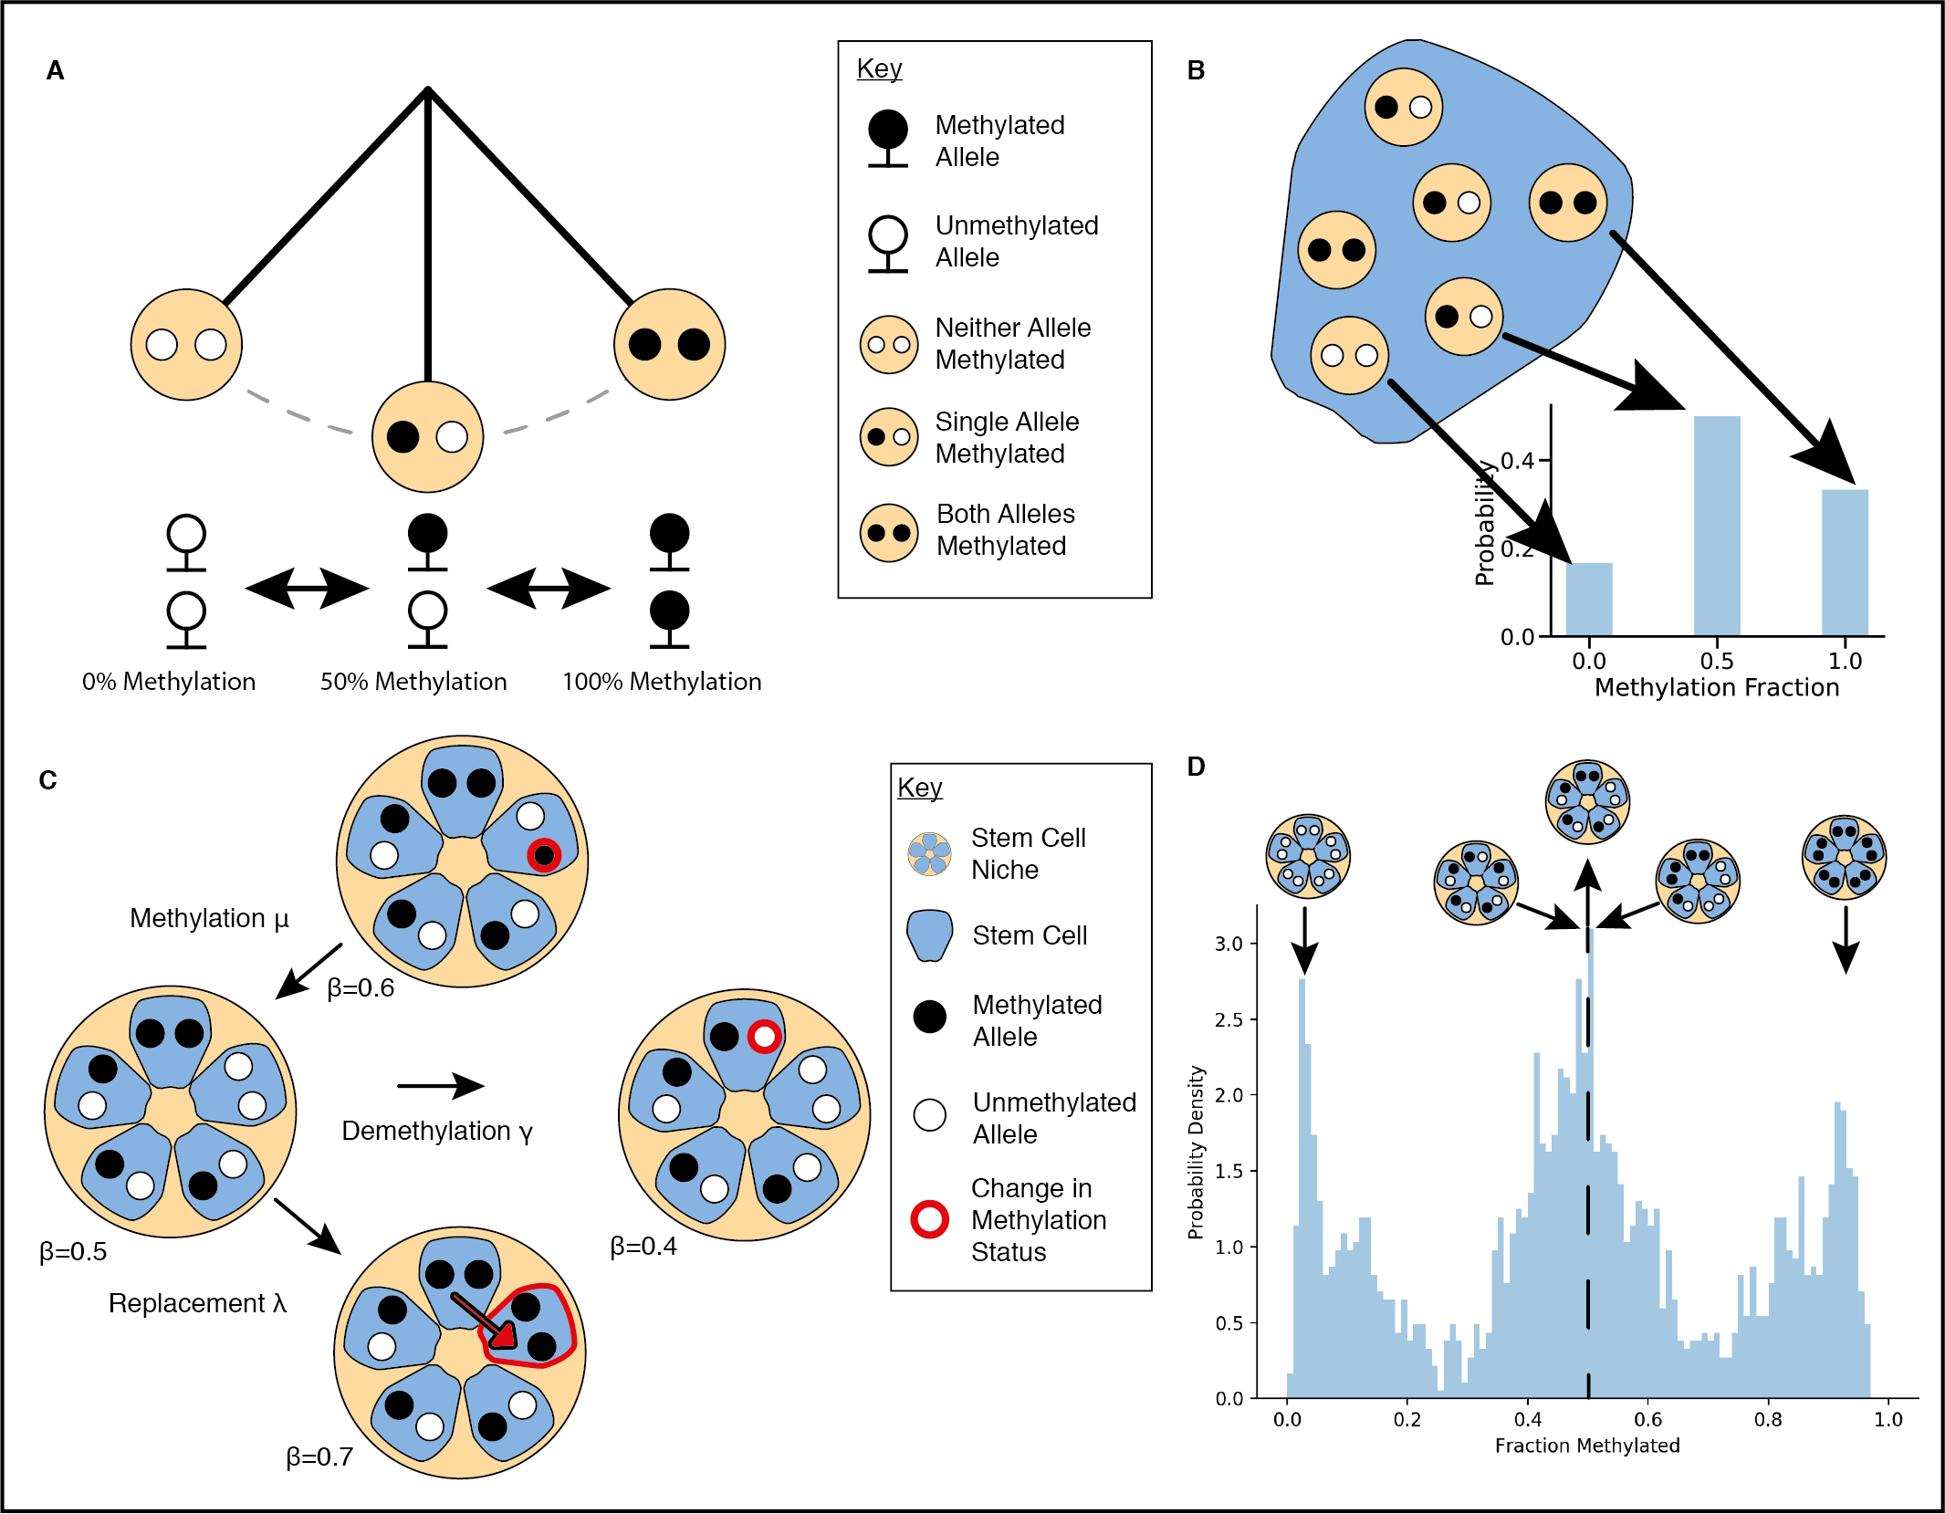
Fluctuating CpG (fCpG) methylation as a lineage tracing marker
Gabbutt et al. (2022)

Slide 5
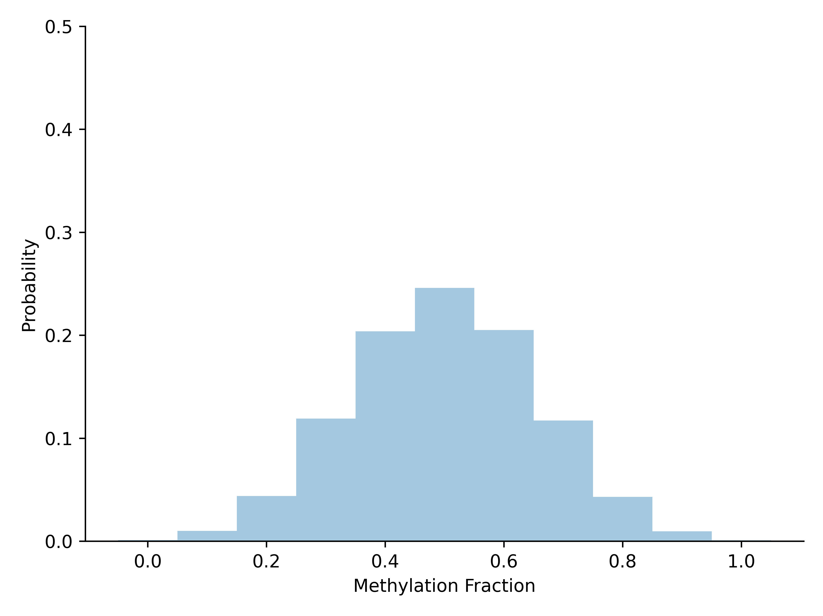
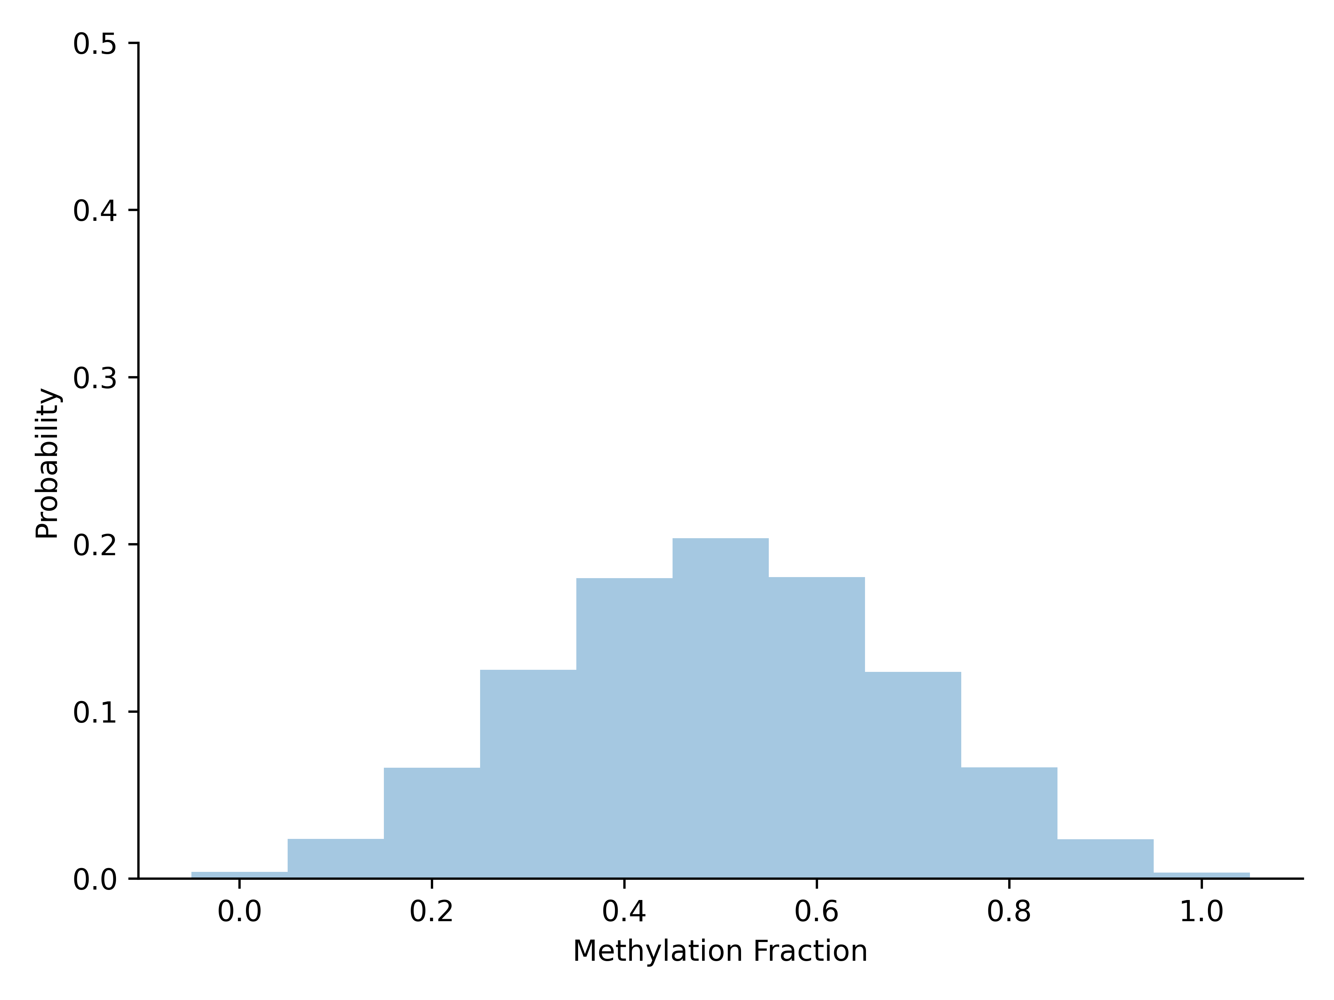
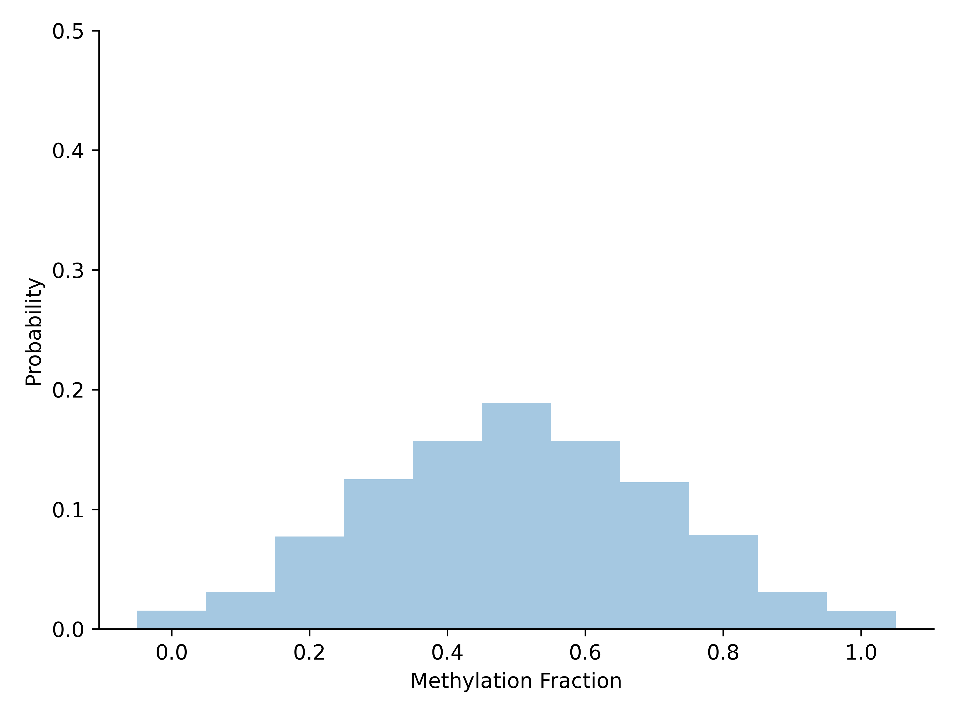
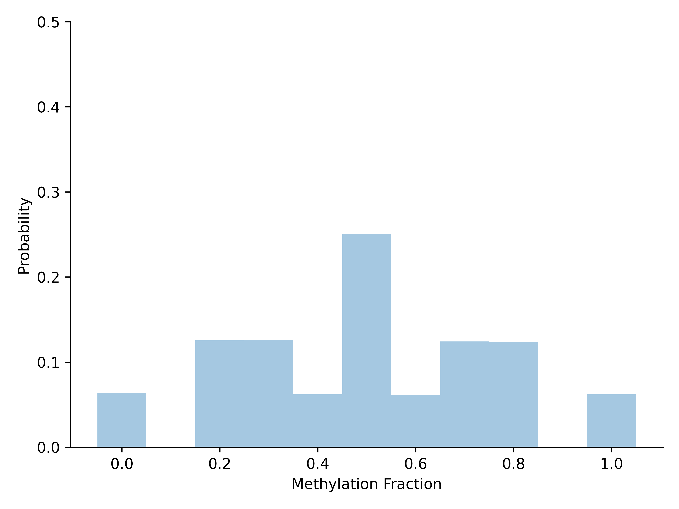
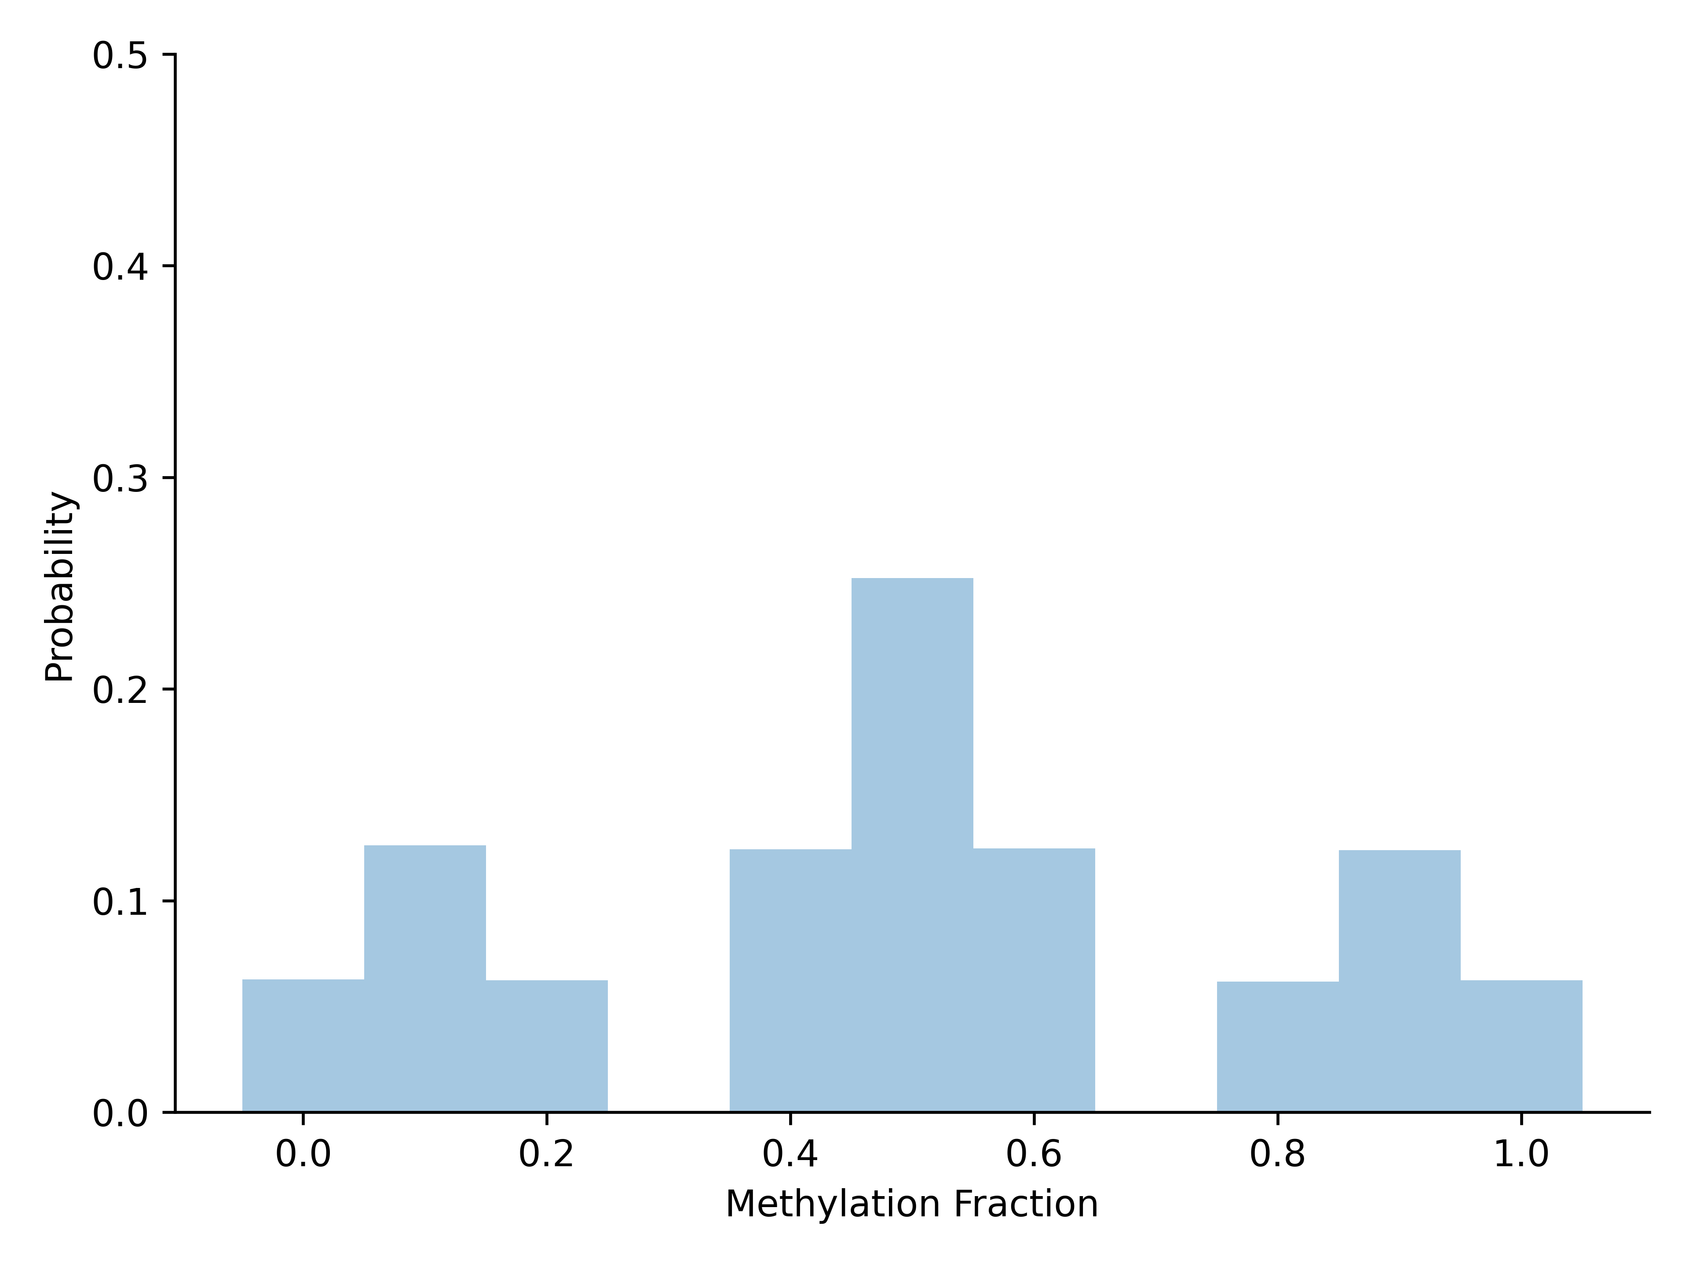
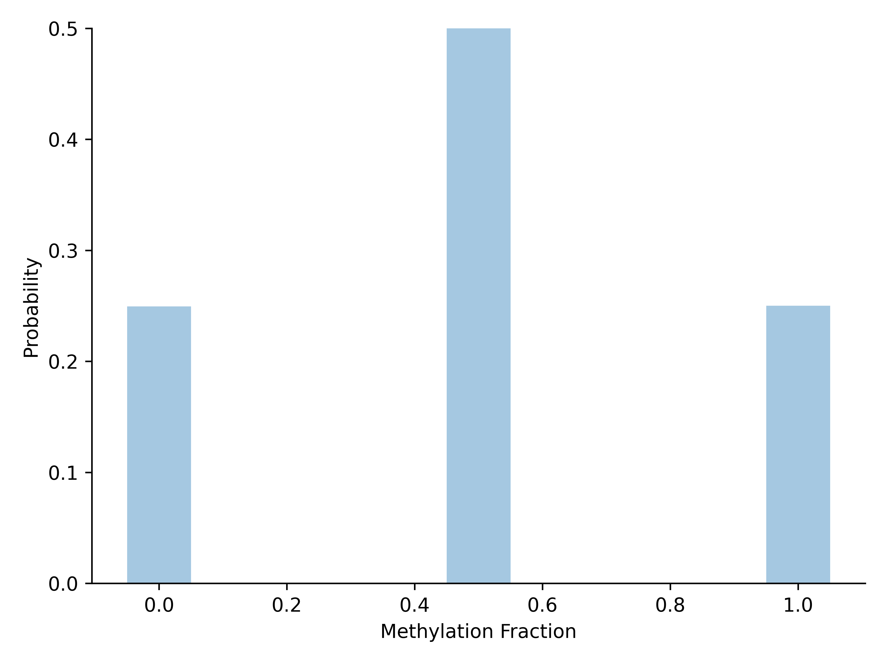
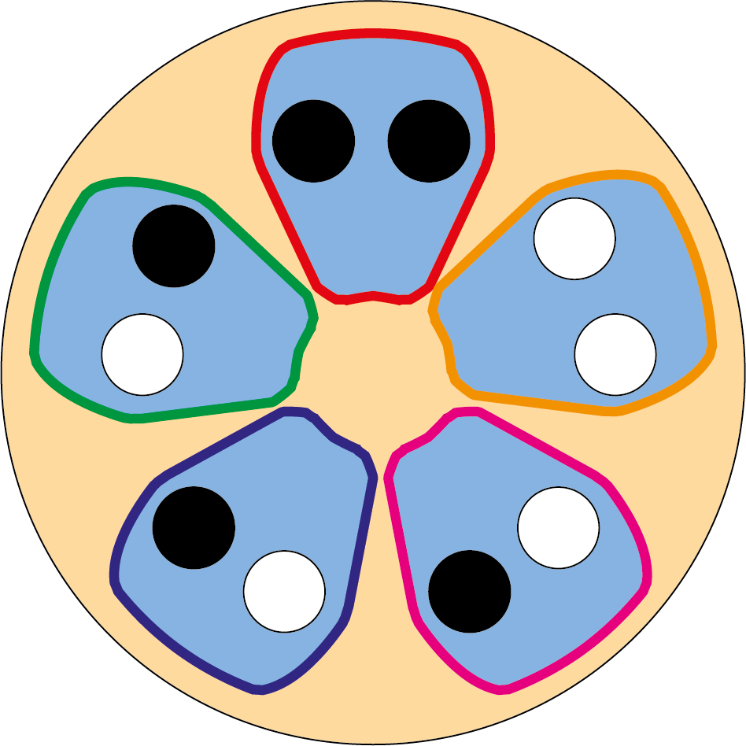
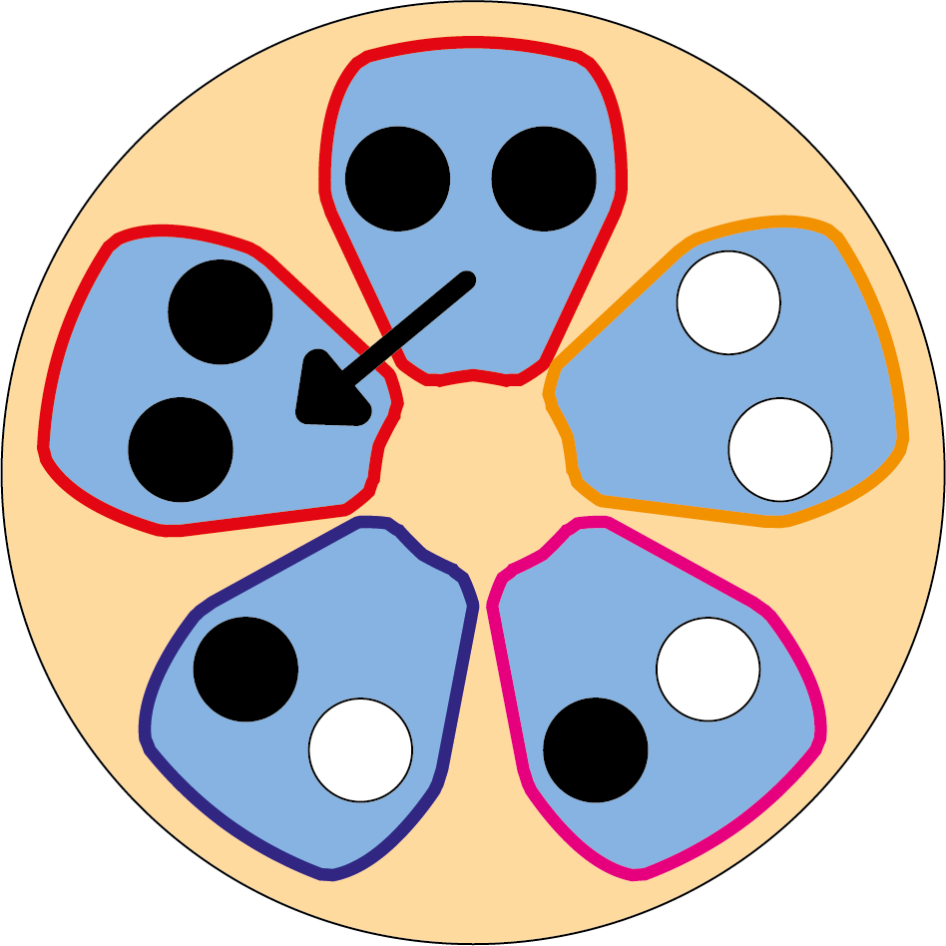
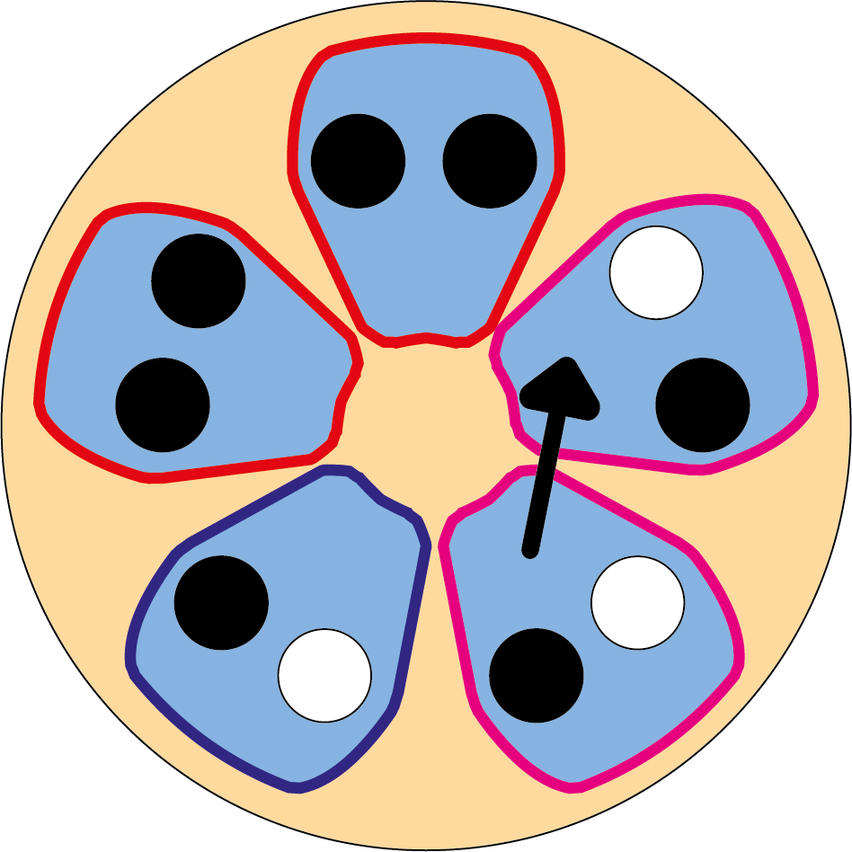
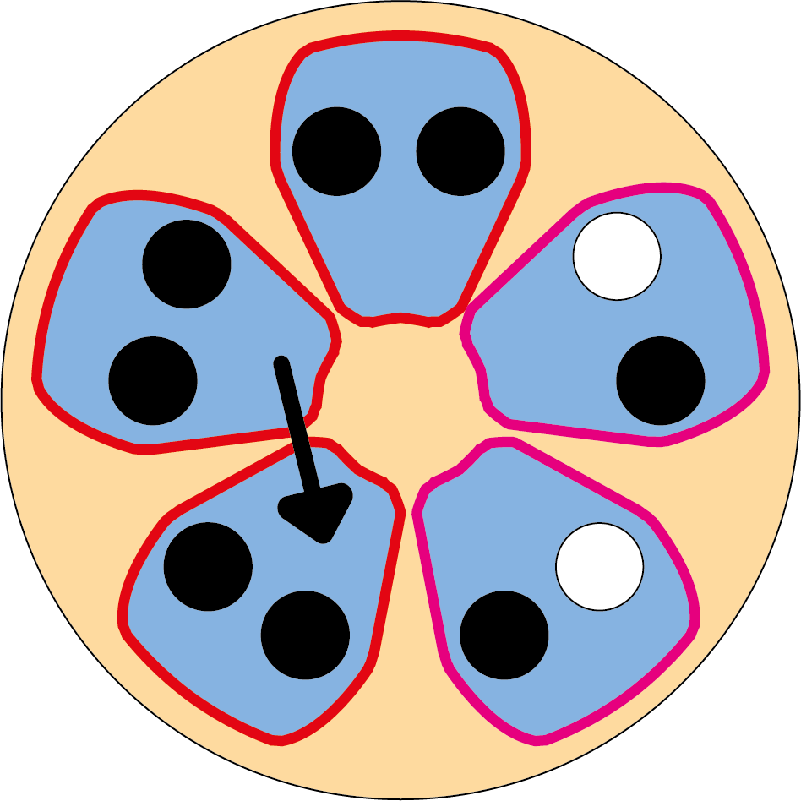
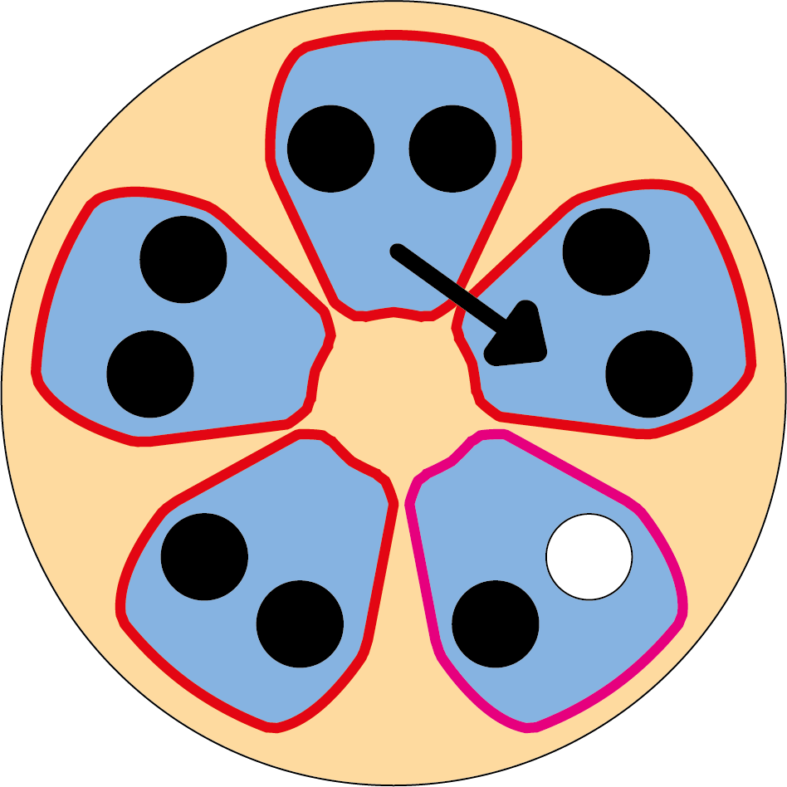
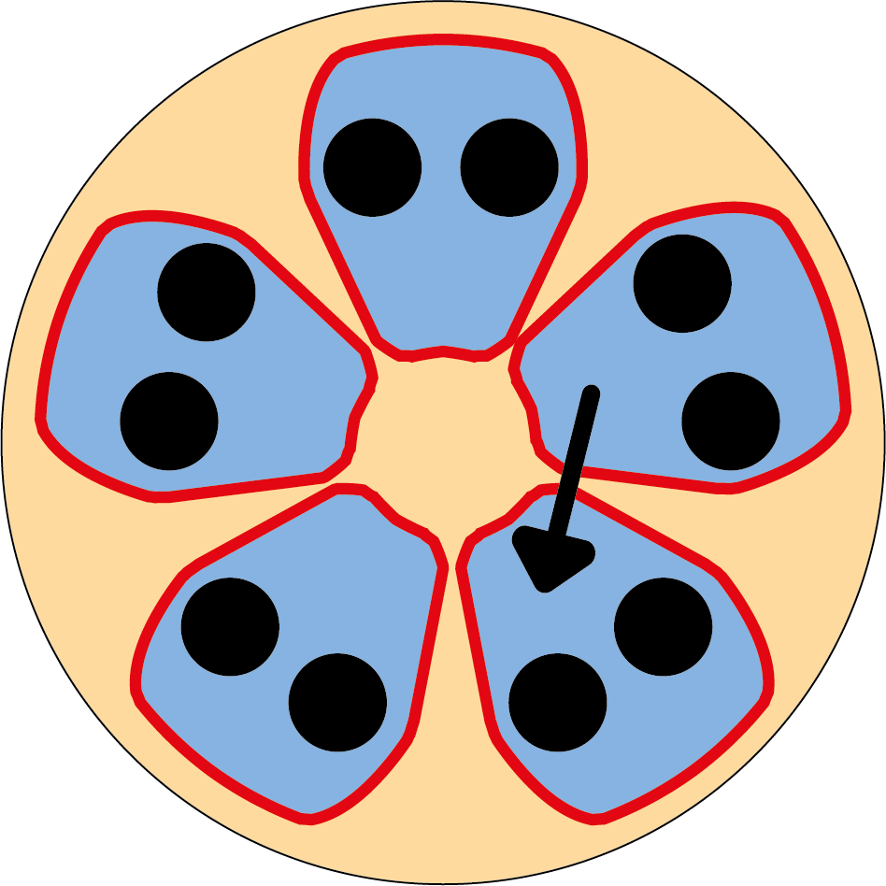
fCpG patterns change during clonal expansion in human colonic crypts
Gabbutt et al. (2022)

Slide 6
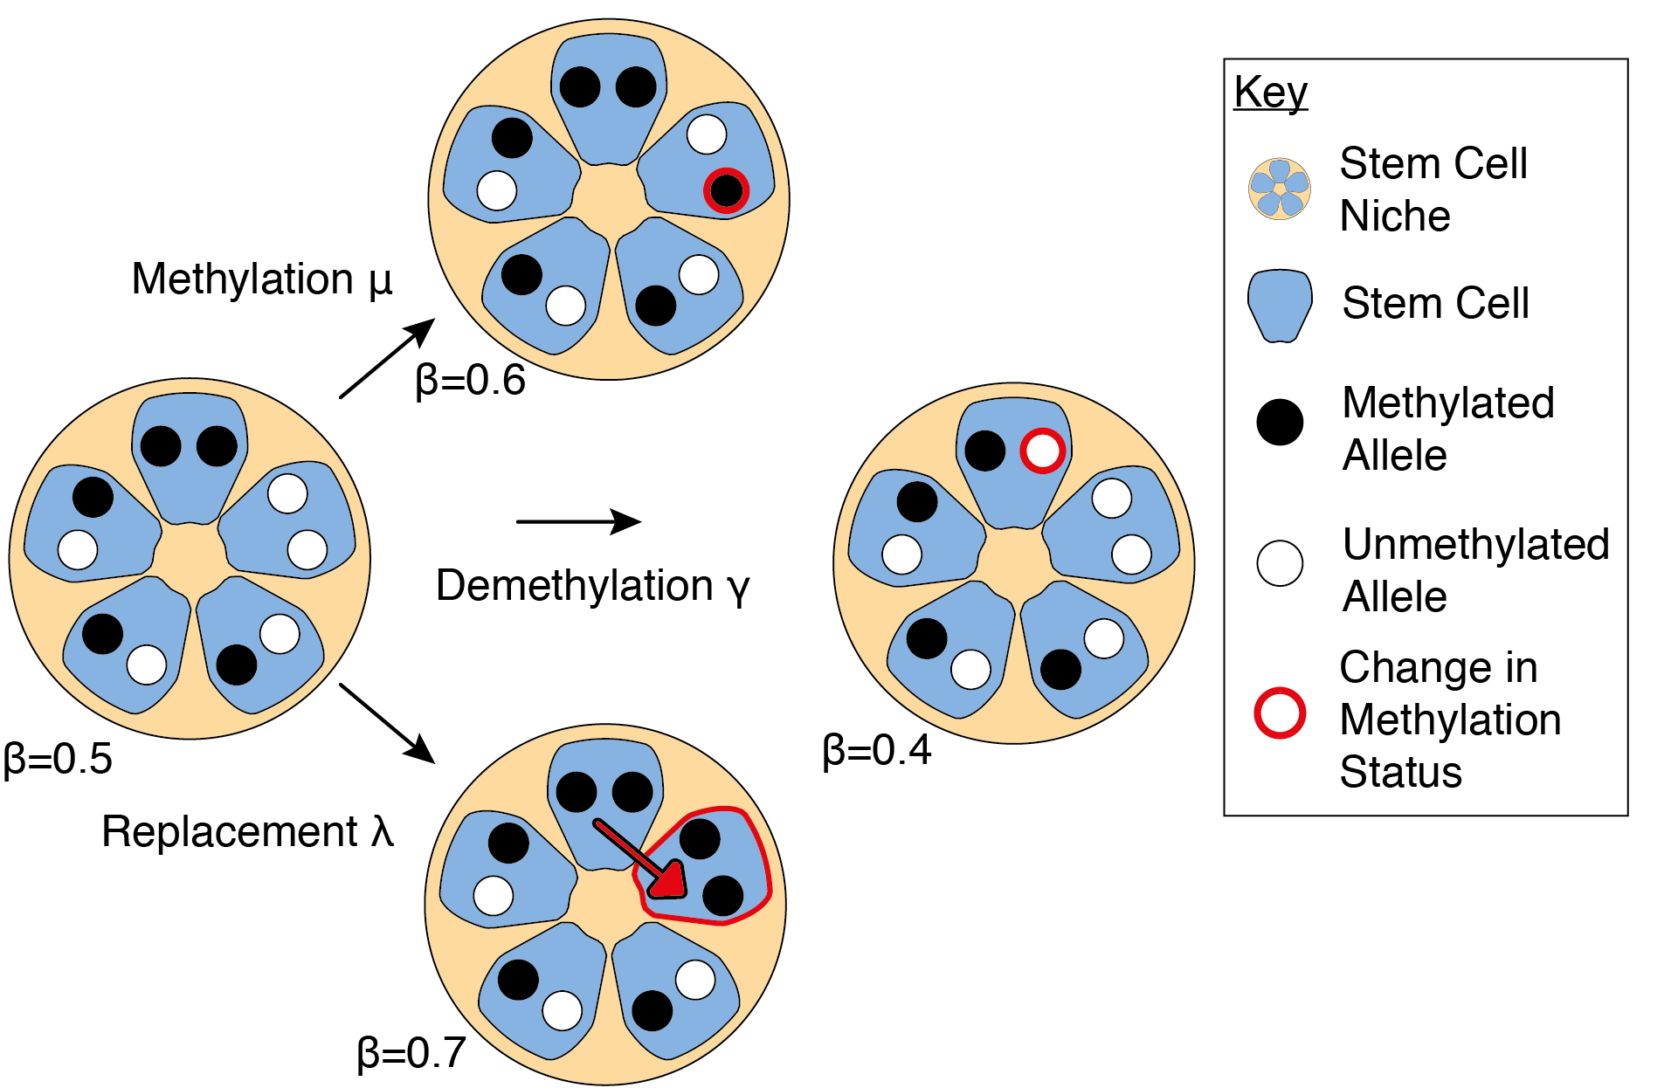
A series of ODEs were used to calculate a likelihood function
Gabbutt et al. (2022)

Slide 7
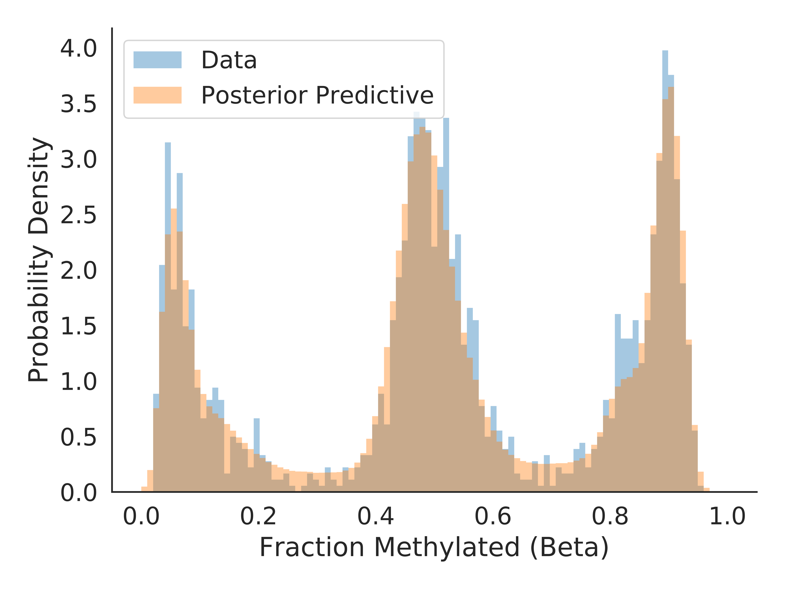
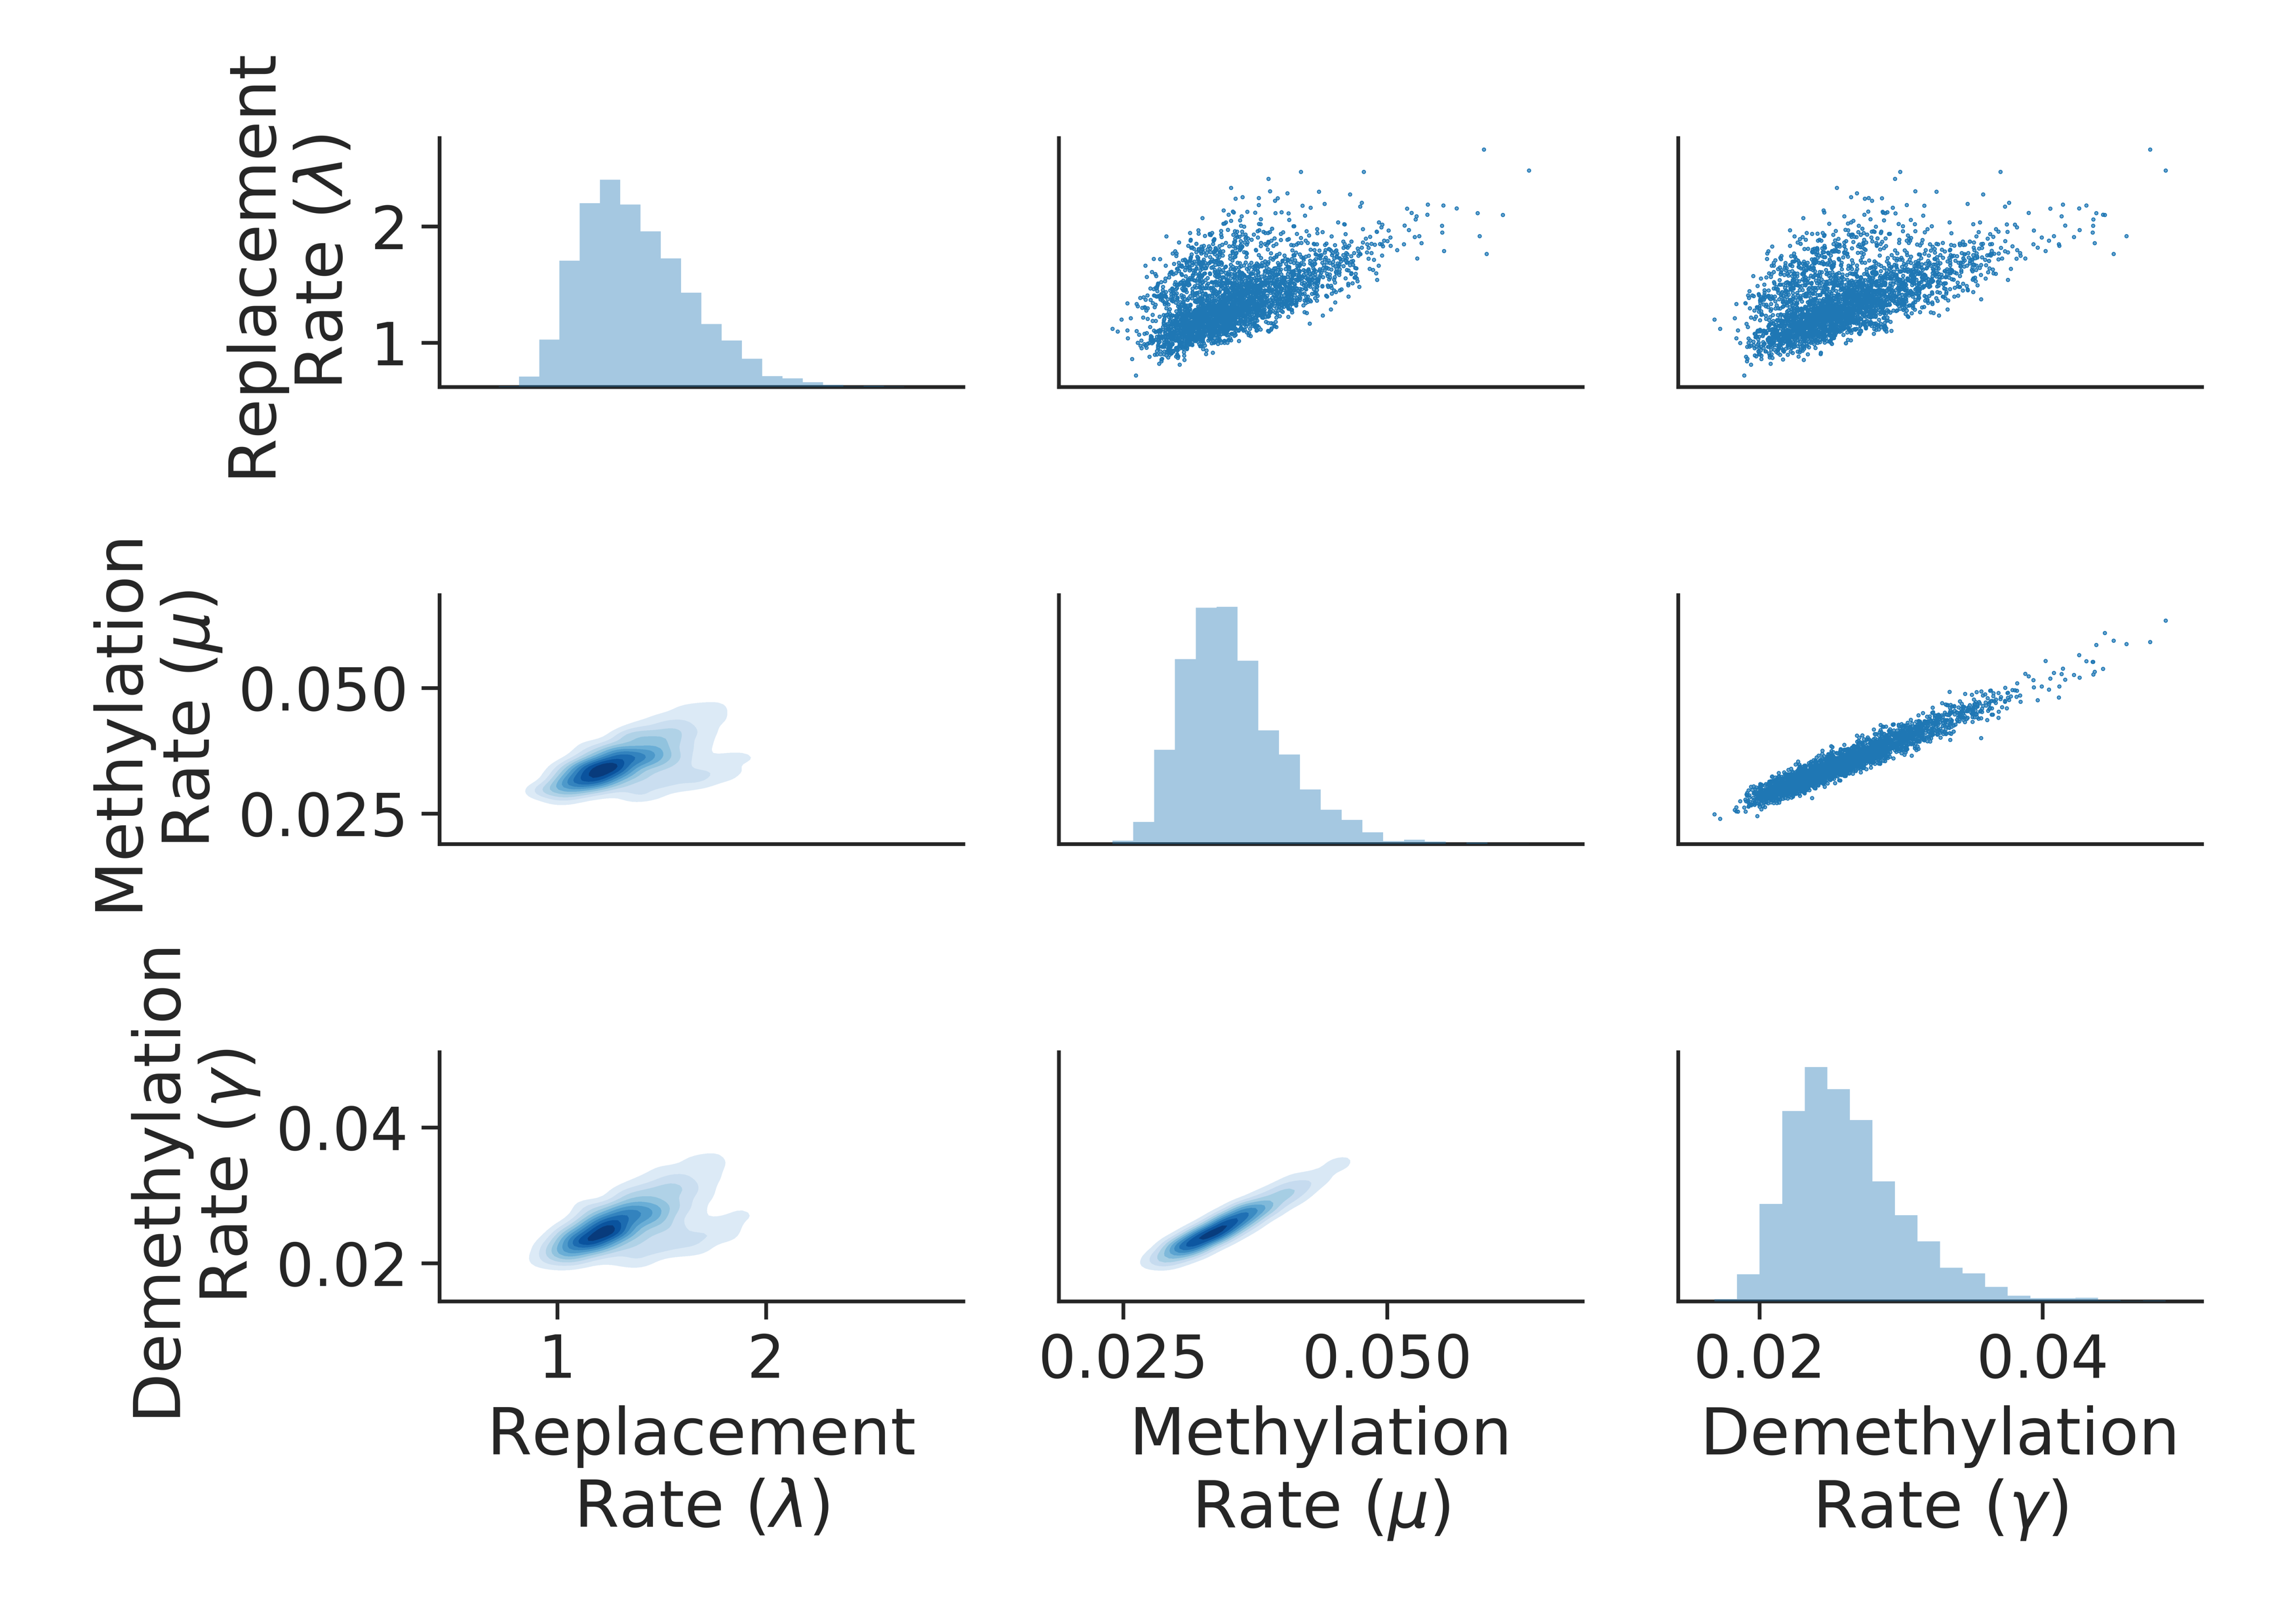
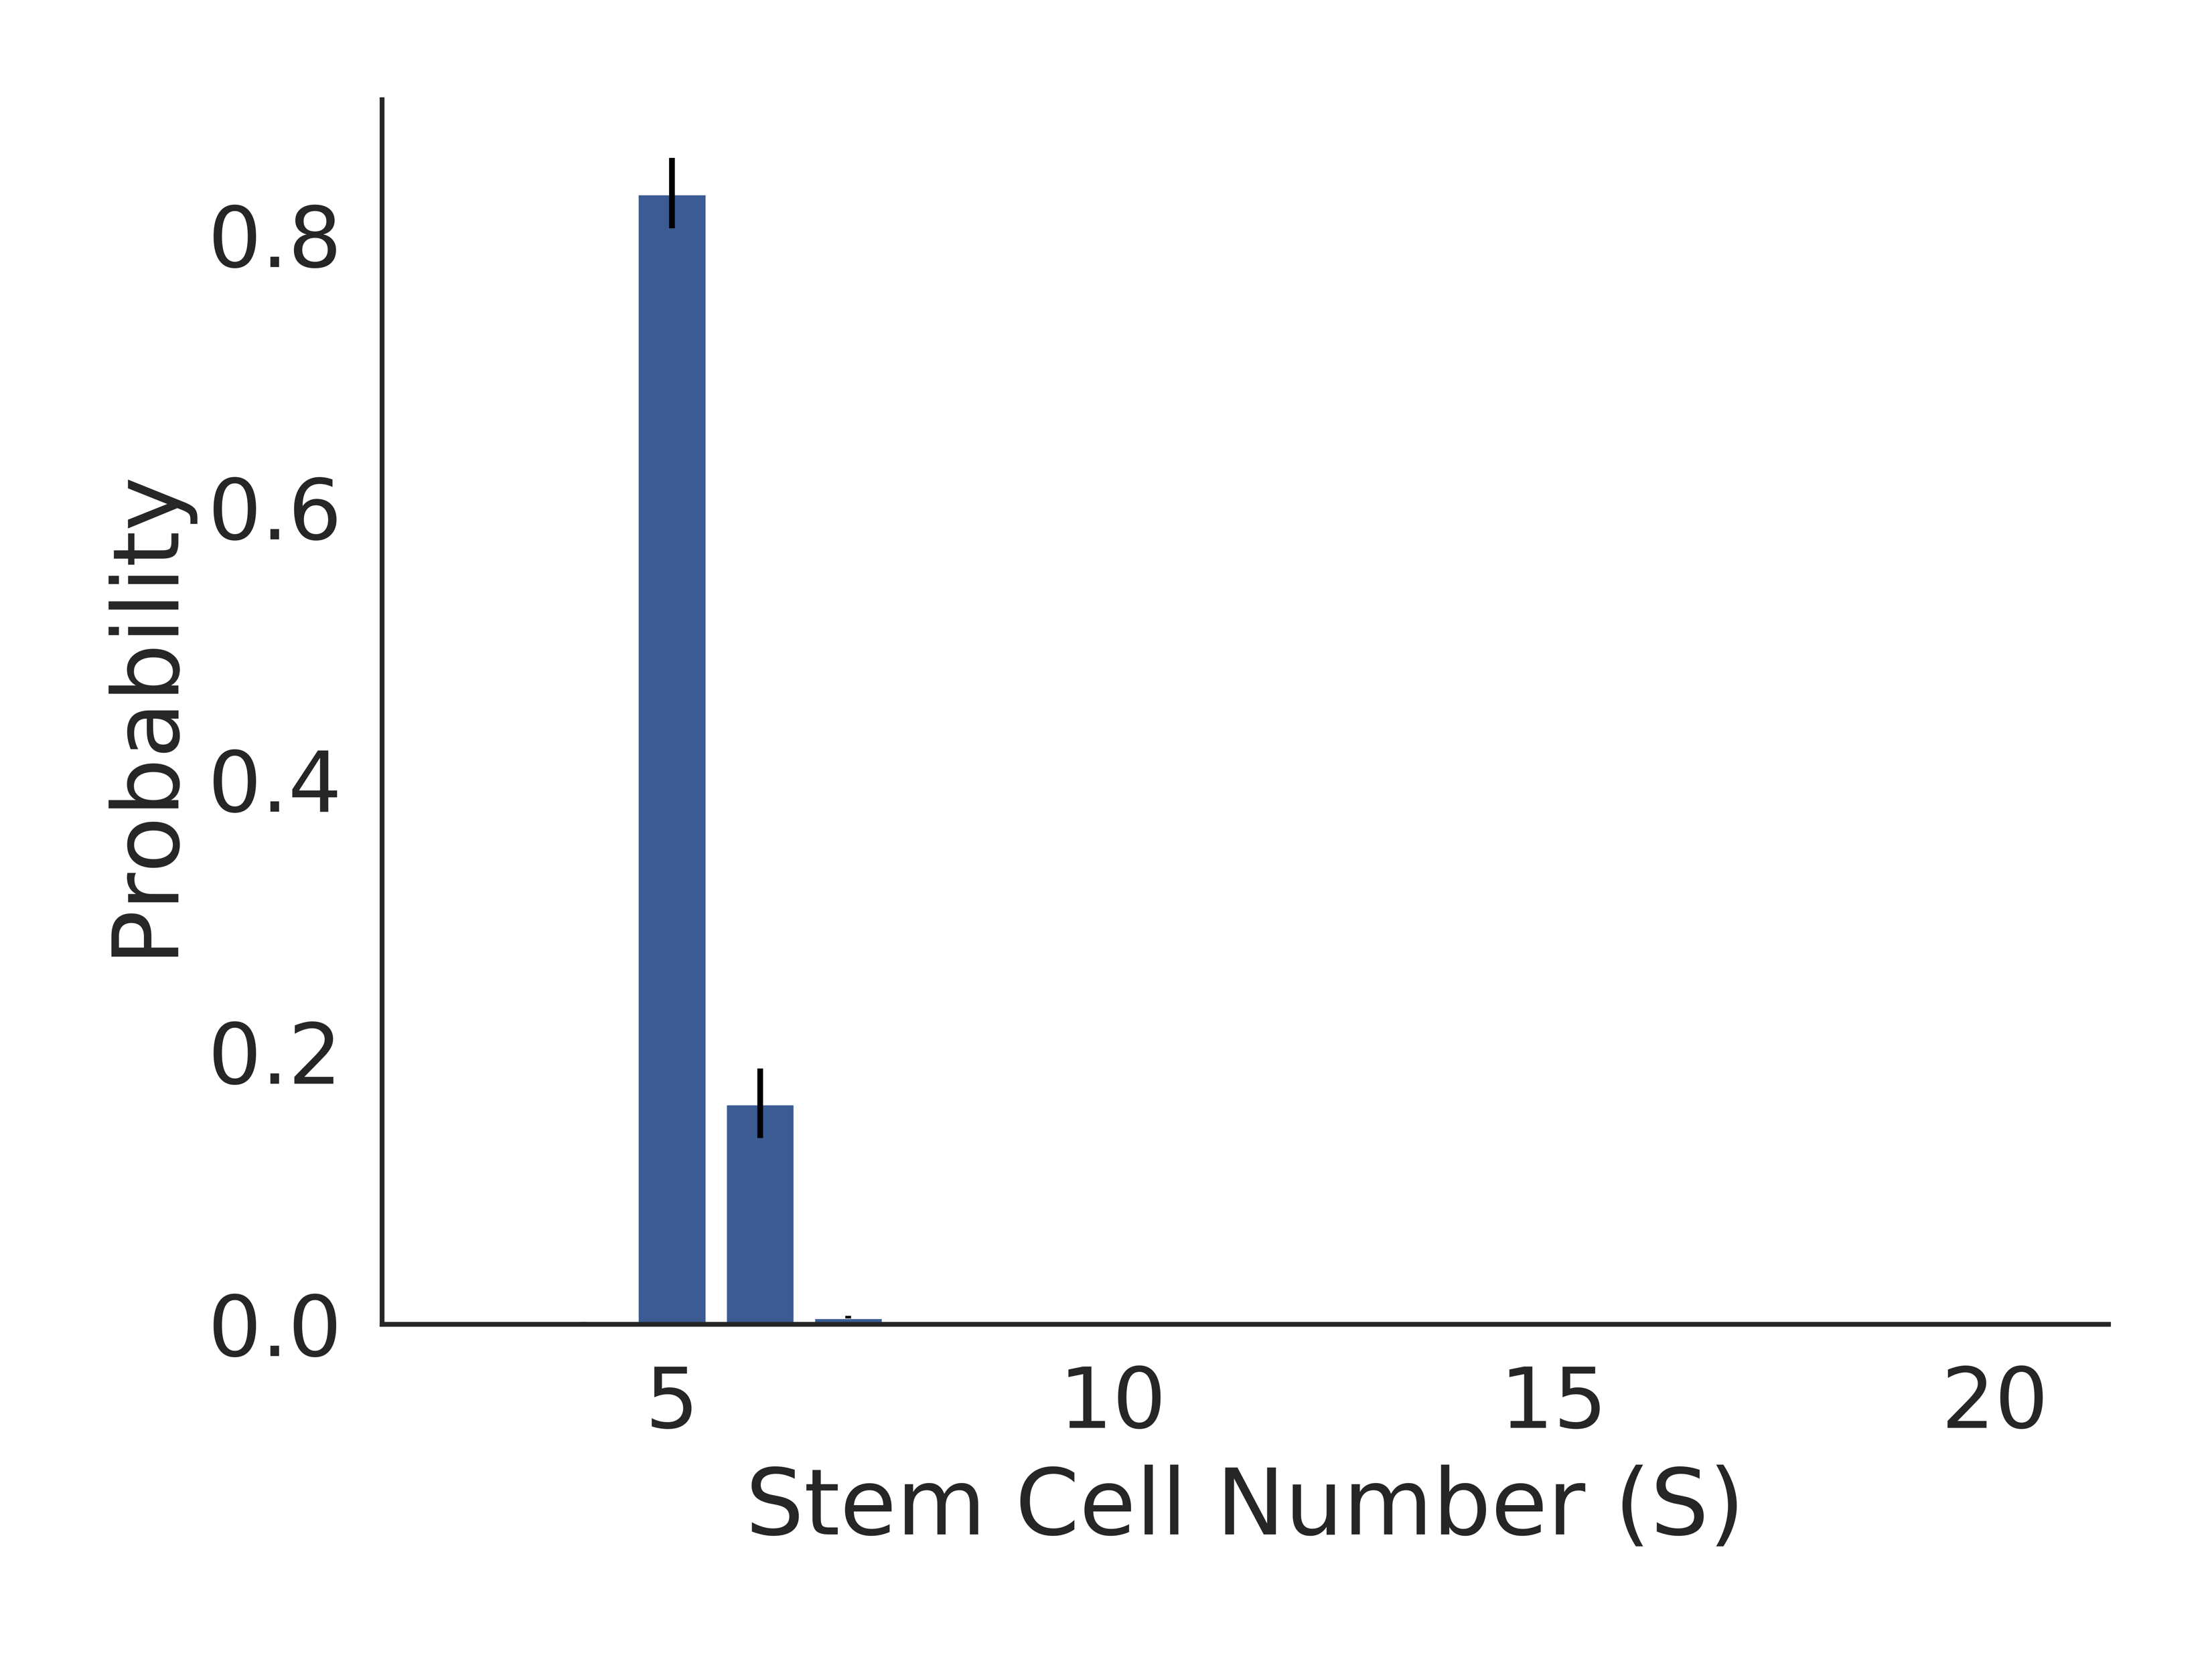
Using this likelihood, we could infer the stem cell dynamics of individual colonic crypts

Slide 8
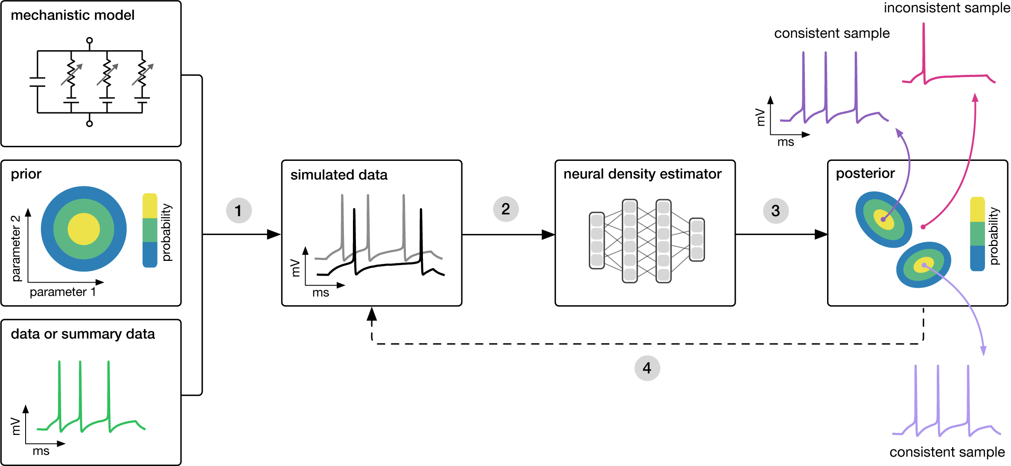
SBI Project
Goal – Explore how to use simulation-based inference to do rapid amortised inference of a real biological system
+
Gabbutt et al. (2022)
Tejero-Cantero et al. (2022)

